Slide 1
Climate Change project update: week 2
Rens Breunissen,
Lotte van Dongen,
Markus Peschl,
Cecilia Casolo,
Maaike Elgersma,
Eva Slingerland,
Simon van Oosterom
Supervised by
Lorinc Meszaros [Deltares]
Robbert Fokkink [TU Delft]
Mathematical Data Science

Slide 2
Inference, Clustering

Slide 3
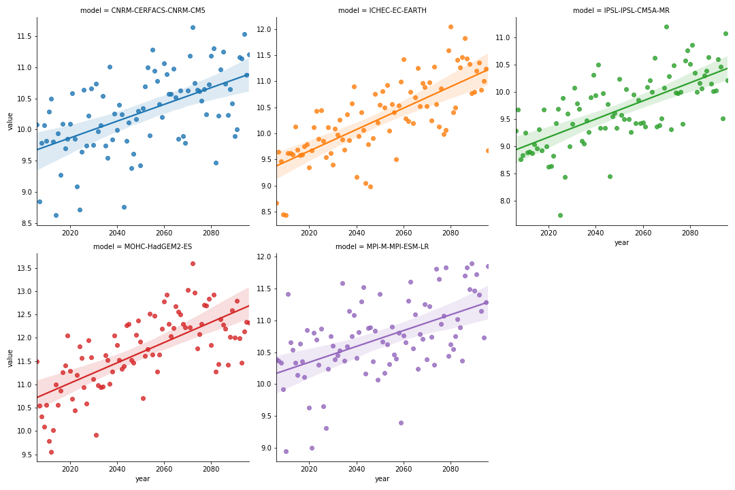
1)
RCP4.5:
Simple Linear Regression for all Models (99% Confidence Intervals)

Slide 4
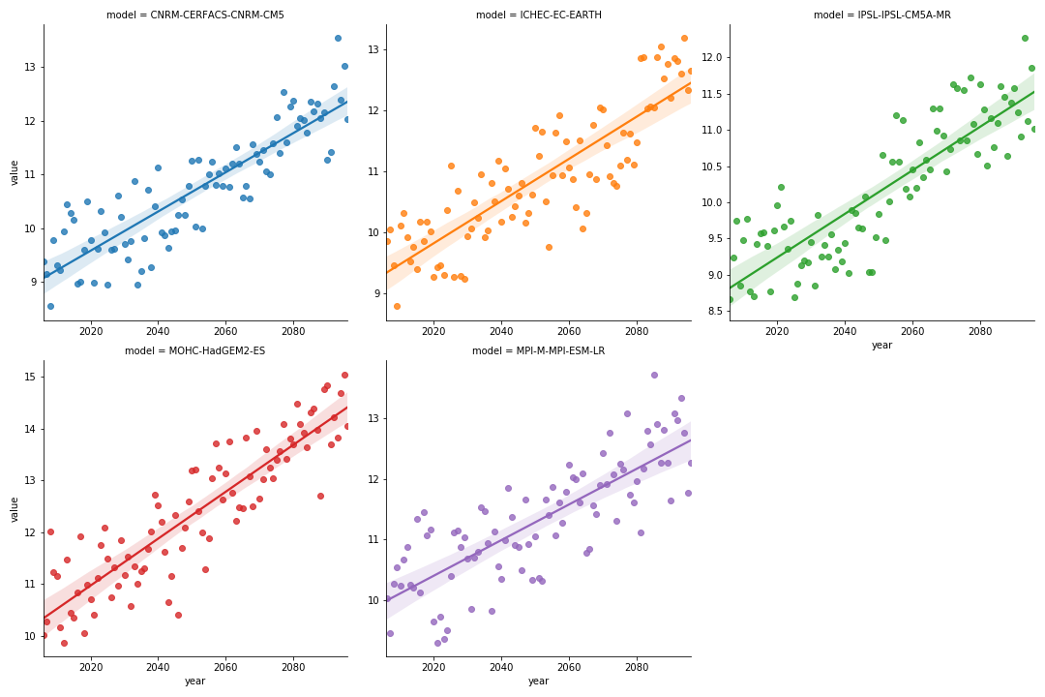
1)
RCP8.5:
Simple Linear Regression for all Models (99% Confidence Intervals)

Slide 5
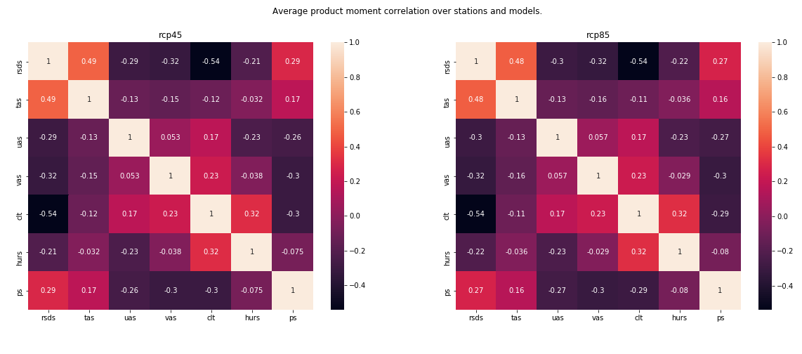
2) Correlation between variables (Averaged over Stations, Models) helps in first interpretation of variables: for example, short wave radiation (sunlight) and cloud cover always very negatively correlated

Slide 6
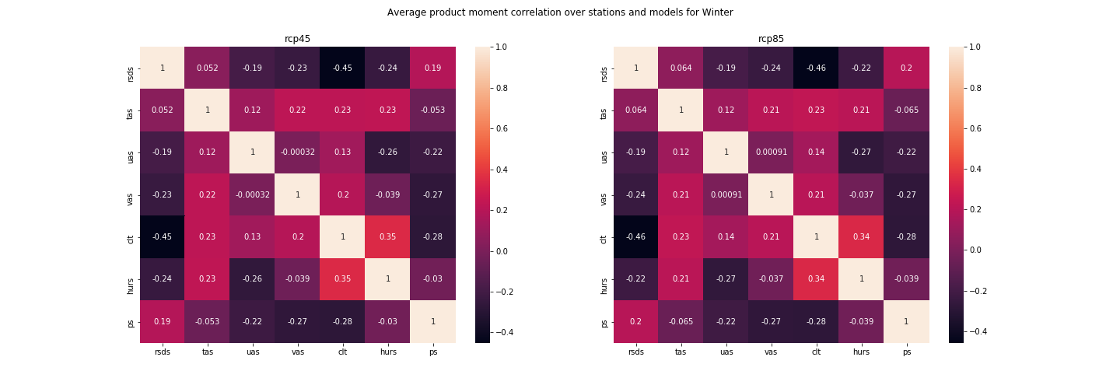
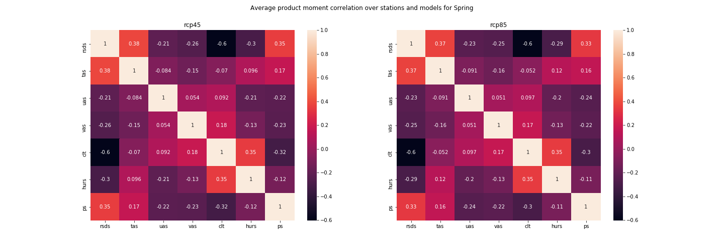
2) Correlation between variables per season First observations: does indeed show differences between seasons. Correlations which change most over the seasons: - short wave radiation and temperature above surface (why?) - east wind and temperature above surface (wind from ocean cools down the near surface temperature in summer/spring (negative correlation), heats up temperature in winter (positive correlation) - cloud cover and temperature above surface

Slide 7
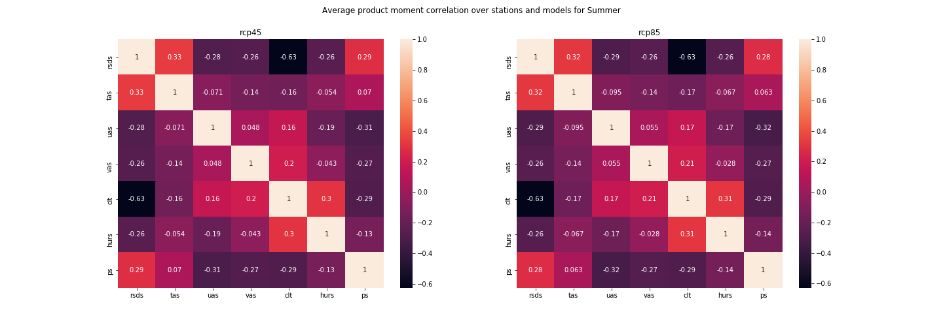
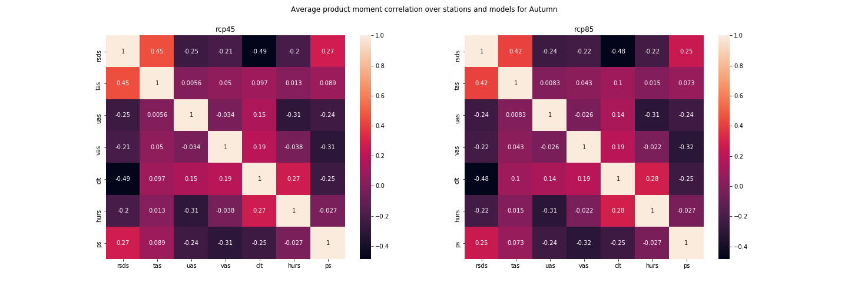
2) Correlation between variables per season

Slide 8
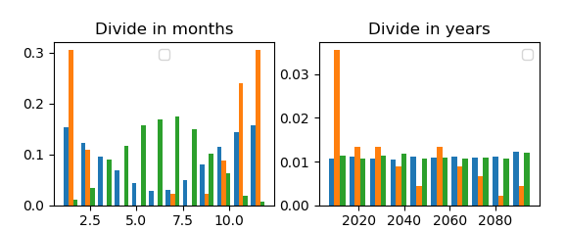
3) Clustering
Setup: standardized all variables, so gave all variables mean zero, variance 1. Next, applied Kmeans clustering for 1 station.
Results for all years in plot on the right. For n=3 we saw a clear distinction between the clusters: one shows the extreme cold months, one the regular cold months and one the summer months.
Idea: Investigate if this differs when we compare clustering for different stations

Slide 9
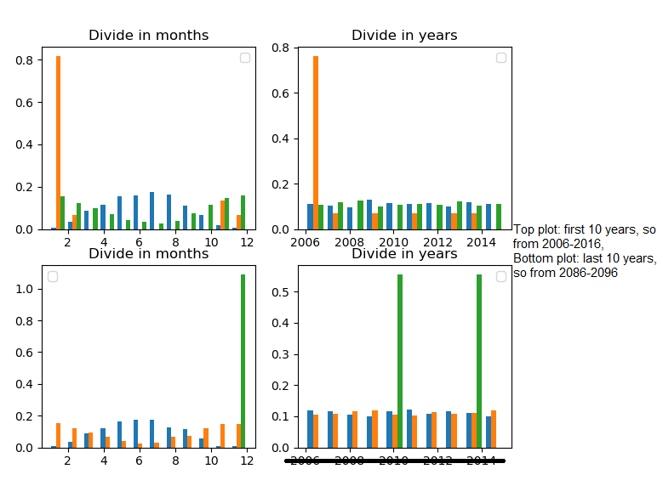
3) Clustering
Idea: We wanted to see if clusters in first and last 10 years differ a lot.
Same setup as previous slide:
Results for first and last 10 years in plot on the right, again for n=3 clusters. No significant difference?
Ideas:
- investigate this for other stations as well.
- see if we can cluster the stations itself

Slide 10
Other plots from the past weeks

Slide 11
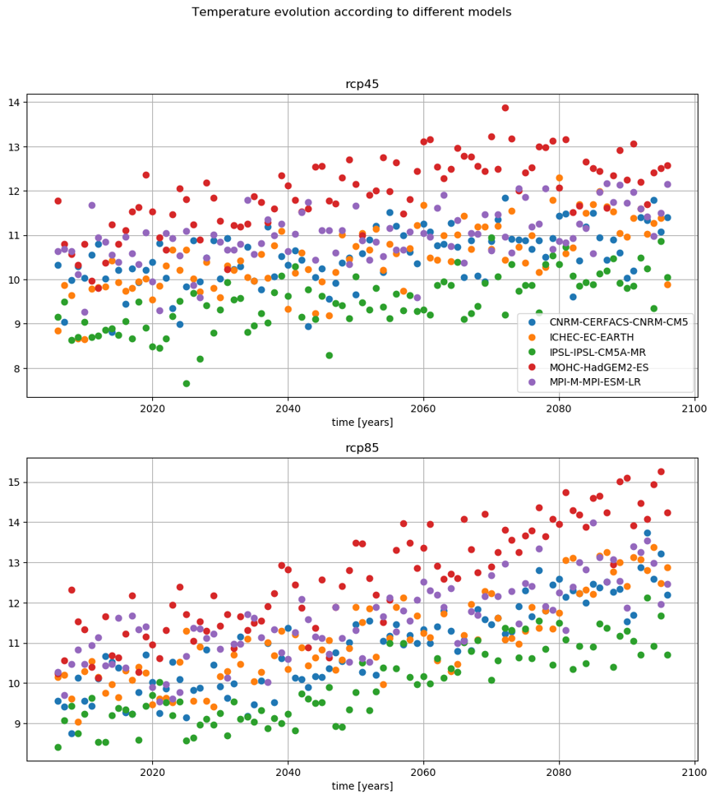
-) Temperature evolution
Yearly average of the temperature increases (obviously) for all models and scenarios.
Distribution of the temperature will be shown in the next slides

Slide 12
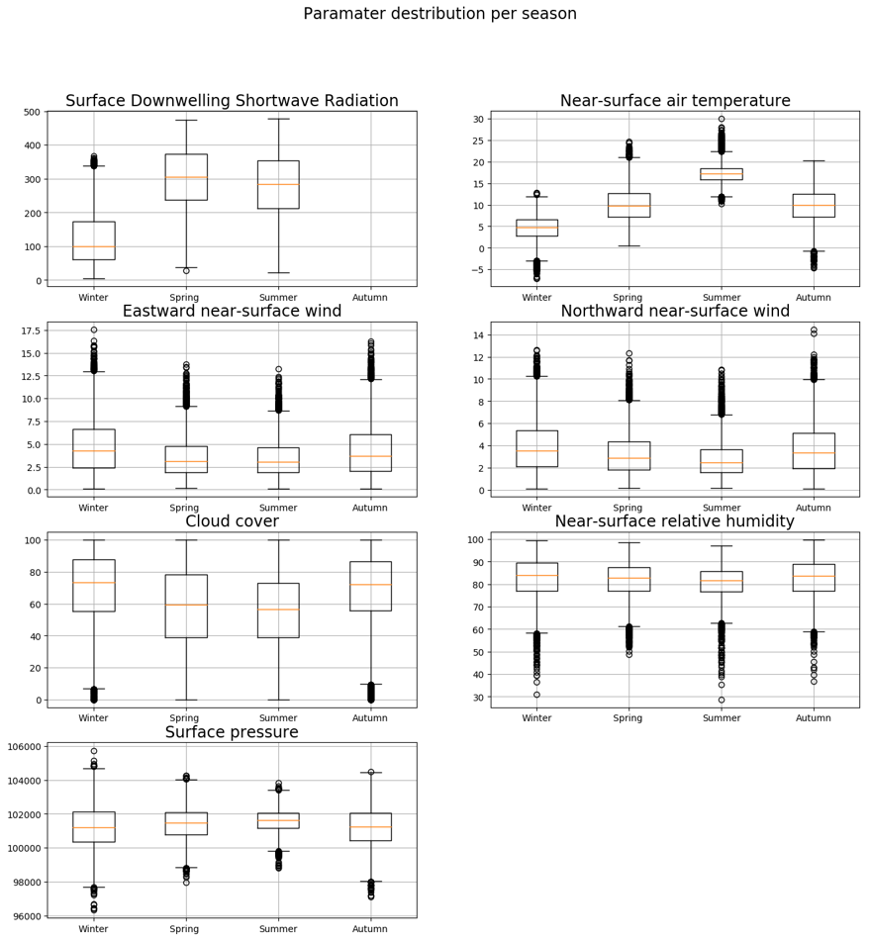
-) Evolution of the distribution of the variables
Boxplots of all variables aggregated over the whole time period

Slide 13
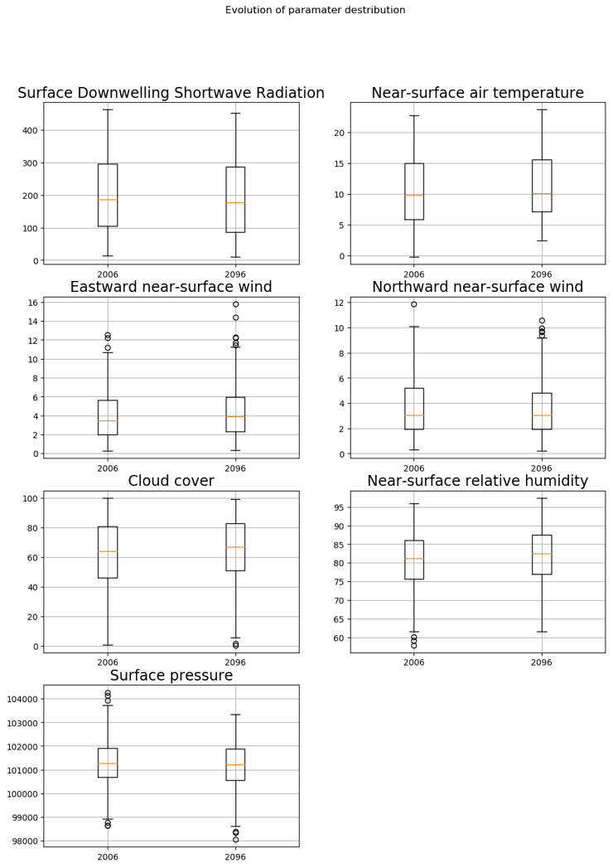
-) Evolution of the distribution of the variables
Comparing 2006 and 2096 as a whole

Slide 14
-) Evolution of the distribution of the variables
Idea: one year is still a relatively small period. As seen in point 3 (time-series plot) the average temperature fluctuates
So, this is the distribution of the variables over a period of 10 years, 2006-2016 and 2086-2096.

Slide 15
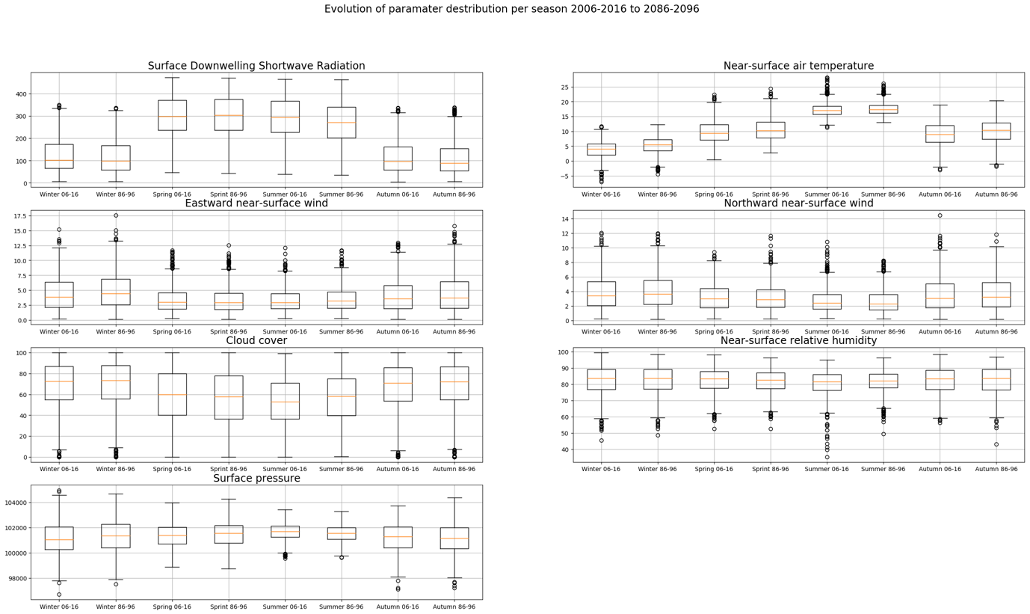
-) Evolution of the distribution of the variables
Idea: The yearly distribution hides seasonal variations in the parameters
So, give a boxplot of the distribution of the parameters per season and over a ten year period.
As can be seen, surprisingly, the temperature distribution in the first period is more spread out then in the last period.
Notice that the wind takes on only positive values?

Slide 16
Research questions

Slide 17
Options
See if we can correlate different variables, does this correlation change over the years/seasons?
See if we can cluster the points in different groups, do the characteristics of these clusters change over the years/seasons?
See if we can compare / correlate different prediction models and experiments, do they present similar characteristics? How can we describe differences between them?

